Slide 1

Technology in Action
15th Edition
Chapter 13
Behind the Scenes: How the Internet Works
Notes:
If this PowerPoint presentation contains mathematical equations, you may need to check that your computer has the following installed:
1) MathType Plugin
2) Math Player (free versions available)
3) NVDA Reader (free versions available)

Slide 2
Learning Objectives (1 of 2)
13.1 Describe the management of the Internet.
13.2 Explain how the Internet’s networking components interact.
13.3 List and describe the Internet protocols used for data transmission.
13.4 Explain how each device connected to the Internet is assigned a unique address.
13.5 Discuss how a numeric IP address is changed into a readable name.
Notes:
Slide 2 is a partial list of textbook Learning Objectives numbers and statements.

Slide 3
Learning Objectives (2 of 2)
13.6 Compare and contrast a variety of web development languages.
13.7 Compare and contrast server-side and client-side application software.
13.8 Discuss the mechanisms for communicating via e-mail and instant messaging.
13.9 Explain how data encryption improves security.
Notes:
Slide 3 is the final list of textbook Learning Objectives numbers and statements.

Slide 4
Internet Management and Networking Management (1 of 2) (Objective 13.1)
Internet Society
Provides leadership for orderly growth and development of the Internet
Internet Engineering Task Force (IETF)
Researches new Internet technologies
Internet Architecture Board (IAB)
Provides direction for the maintenance and development of Internet protocols
Notes:
Some of the organizations that play a part in Internet governance and development include:
Internet Society which provides leadership for orderly growth and development of the Internet.
Internet Engineering Task Force (IETF) which researches new Internet technologies.
Internet Architecture Board (IAB) which provides direction for the maintenance and development of Internet protocols.

Slide 5
Internet Management and Networking Management (2 of 2) (Objective 13.1)
Internet Corporation for Assigned Names and Numbers (ICANN)
Responsible for managing the Internet’s domain name system and the allocation of IP addresses
World Wide Web Consortium (W3C)
Sets standards and develops protocols for the web
Notes:
Other organizations that play a part in Internet governance and development include:
Internet Corporation for Assigned Names and Numbers (ICANN) which is responsible for managing the Internet’s domain name system and the allocation of IP addresses.
World Wide Web Consortium (W3C) which sets standards and develops protocols for the web.

Slide 6
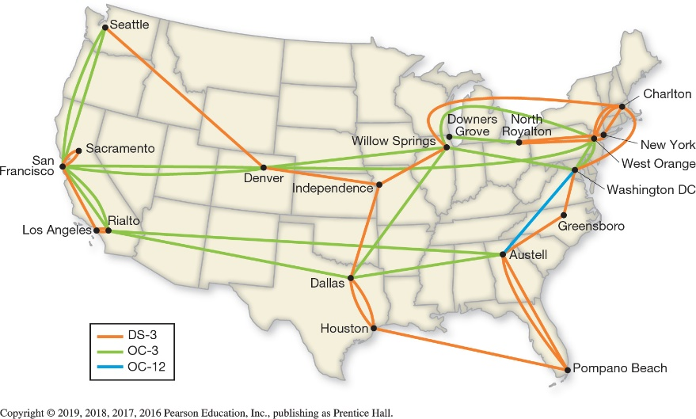
Internet Management and Networking Networking Components (1 of 3) (Objective 13.2)
Internet backbone
Main paths of the Internet
Data travels the fastest
Collection of large national and international networks
Optical carrier line
Fiber-optic
Notes:
As a “network of networks,” the Internet is similar to the U.S. highway system, where smaller roads feed into larger, faster highways.
The main paths of the Internet are known collectively as the Internet backbone.
The Internet backbone is a collection of large national and international networks, most of which are owned by commercial, educational, or government organizations.
These backbone providers, which are required to connect to other backbone providers, have the fastest high-speed connections.
A backbone is typically a high-speed fiber-optic line, designated as an optical carrier (OC) line.

Slide 7
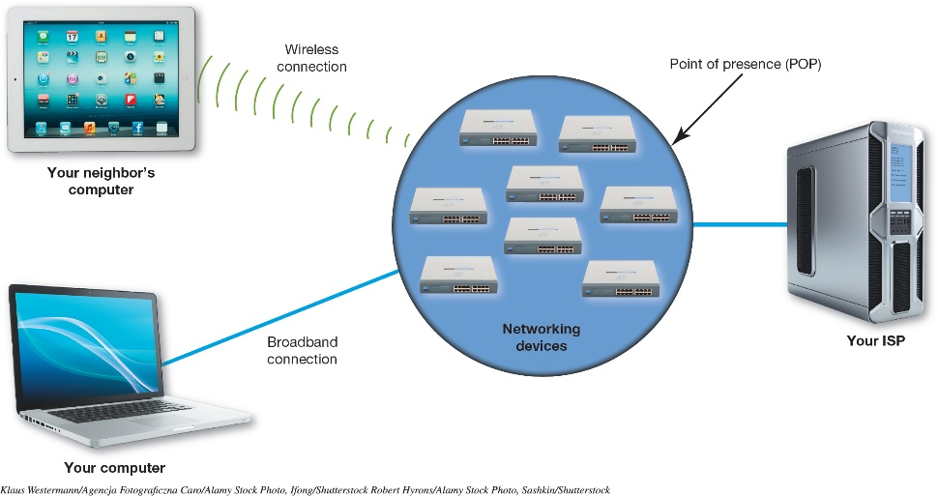
Internet Management and Networking Networking Components (2 of 3) (Objective 13.2)
Internet exchange point (IXP)
Used for connecting ISPs
One or more network switches
Point of presence (POP)
Used for individuals
Bank of modems, servers, routers, and switches
Notes:
ISPs like Verizon and Comcast are connected together through an Internet exchange point (IXP).
A typical IXP is made up of one or more network switches to which ISPs connect.
Individual Internet users enter an ISP through a point of presence (POP).
This is a bank of modems, servers, routers, and switches.
Figure 13.3 shows how home users connect to their ISPs through a single point of presence that can handle many simultaneous connections.

Slide 8
Internet Management and Networking Networking Components (3 of 3) (Objective 13.2)
Client/server model is used for Internet
Common servers
Web servers host web pages and provide information to clients
Commerce servers enables users to buy goods and services
File servers provide remote storage space
Notes:
The majority of Internet communications follow the client/server model of network communications.
Common servers include:
Web servers host web pages and provide information to clients.
Commerce servers enables users to buy goods and services.
File servers provide remote storage space.

Slide 9
Internet Management and Networking Data Transmission (1 of 4) (Objective 13.3)
Network follows standard protocols to send information
Protocol is a set of rules for exchanging electronic information
They are the “rules of the road” for the information superhighway
Open as apposed to proprietary system
Notes:
Just like any other network, the Internet follows standard protocols to send information between computers.
A computer protocol is a set of rules for exchanging electronic information.
If the Internet is the information superhighway, then protocols are the rules of the road.
Each protocol had to be an open system, meaning its design would be made public for access by any interested party. This was in direct opposition to the proprietary system (private system) model that was the norm at the time.

Slide 10
Internet Management and Networking Data Transmission (2 of 4) (Objective 13.3)
Circuit switching is not used to connect two computers
Inefficient when applied to computers
Computers transmit data in a group, or burst
Processor works on the next task and ceases to communicate until ready to transmit next burst
Circuit would have to remain open
Notes:
Circuit switching is inefficient. As a computer processor performs the operations necessary to complete a task, it transmits data in a group, or burst.
The processor begins on its next task and ceases to communicate with output devices or other networks until it’s ready to transmit in the next burst.
Circuit switching is inefficient because either the circuit would have to remain open or it would have to be reestablished for each burst.

Slide 11
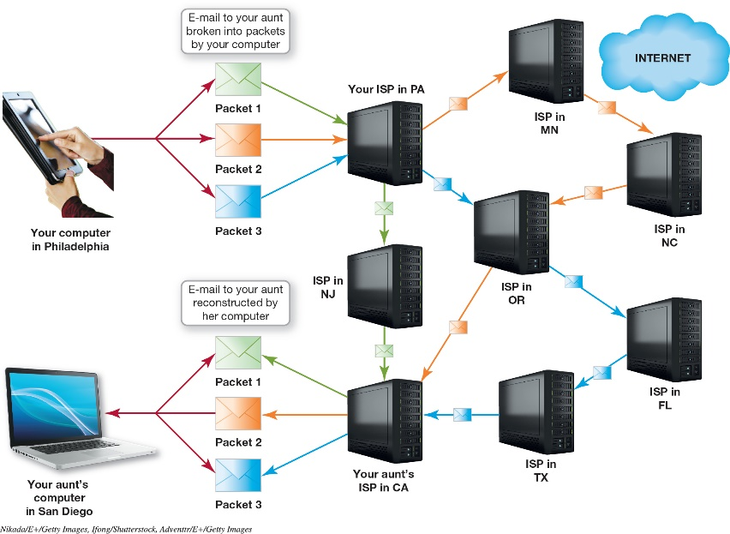
Internet Management and Networking Data Transmission (3 of 4) (Objective 13.3)
Packet switching makes computer communication efficient
Packets are chunks of data
Address to which the packet is being sent
Address from where the packet originates
Reassembly instructions
Data that is being transmitted
Notes:
Packet switching makes computer communication efficient.
With packet switching, data is broken into smaller chunks called packets. These contain:
An address to which the packet is being sent.
The address from where the packet originates.
Reassembly instructions, if the original data is split between packets.
The data that’s being transmitted.
As Figure 13.4 demonstrates, each packet sent through the Internet can follow its own route to its final destination. Sequential numbering of packets ensures they’re reassembled in the correct order at their destination.

Slide 12
Internet Management and Networking Data Transmission (4 of 4) (Objective 13.3)
TCP/IP is the main suite of protocols on the Internet
Consists of many interrelated protocols
Transmission Control Protocol (TCP)
Internet Protocol (IP) is responsible for sending the information from one computer to another
Notes:
Although many protocols are available on the Internet, the main suite of protocols used is TCP/IP.
The suite is named after the original two protocols that were developed for the Internet: the Transmission Control Protocol (TCP) and the Internet Protocol (IP).
Although most people think that the TCP/IP suite consists of only two protocols, it actually includes many interrelated protocols.

Slide 13
Internet Identity IP Addresses (1 of 3) (Objective 13.4)
Each device is required to have a unique number
Called the IP address
Internet Corporation for Assigned Names and Numbers (ICANN) ensures addresses are unique
Dotted decimal / Dotted quad / Octet
Notes:
Each computer, server, or device connected to the Internet is required to have a unique identification number, or IP address.
The Internet Corporation for Assigned Names and Numbers (ICANN) ensures that IP addresses are unique and haven’t been assigned to other users. ICANN is responsible for allocating IP addresses to network administrators.
An IP address in this form is called a dotted decimal number (or a dotted quad). Each of the four numbers in a dotted decimal number is referred to as an octet.

Slide 14
Internet Identity IP Addresses (2 of 3) (Objective 13.4)
Internet Protocol version 4 (IPv4)
Created in 1981
Over 4 billion possible values
Is becoming upgrown
Internet of Things (IoT) is the explosive growth of Internet-enabled devices
Internet Protocol version 6 (IPv6)
Developed to provide more available IP addresses
Notes:
Internet Protocol version 4 (IPv4), was created in 1981. Four billion values for an address field seemed like enough to last forever. However, as the Internet grew, we are running out of IP addresses.
The Internet of Things (IoT) is a term for the explosive growth of Internet-enabled devices.
Internet Protocol version 6 (IPv6) is an IP addressing scheme developed by the IETF to make IP addresses longer, thereby providing more available IP addresses.

Slide 15
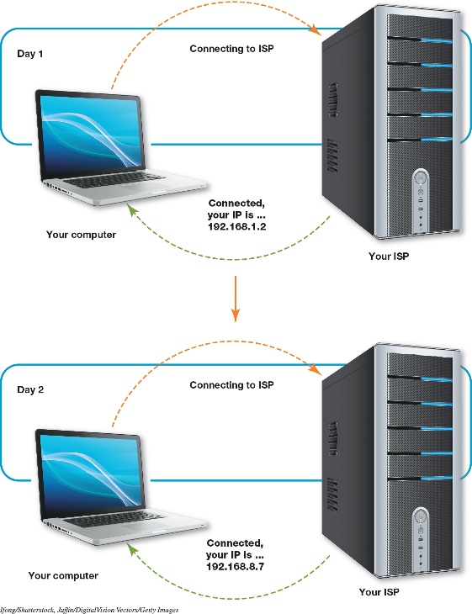
Internet Identity IP Addresses (3 of 3) (Objective 13.4)
How a computer gets an IP address (either/or)
Static
IP address never changes
Assigned by network administrator or ISP
Dynamic
IP address is temporary
Assigned from pool of addresses
More common
DCHP shares IP addresses as needed
Notes:
IP addresses are assigned either statically or dynamically:
Static addressing means that the IP address never changes.
Dynamic addressing, in which your computer is assigned a temporary address from an available pool of IP addresses, is more common.
Dynamic Host Configuration Protocol (DHCP), which belongs to the TCP/IP protocol suite. DHCP takes a pool of IP addresses and shares them with hosts on the network on an as-needed basis.

Slide 16
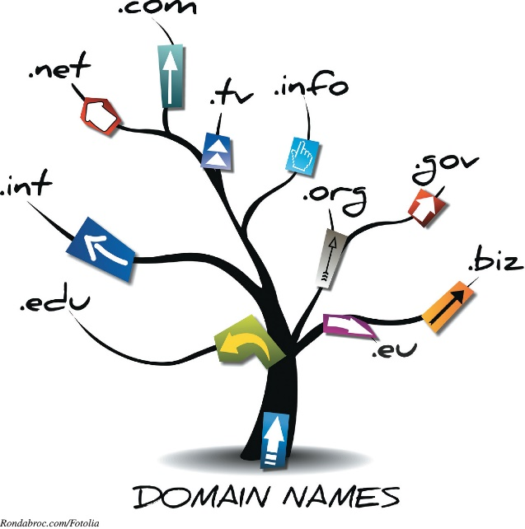
Internet Identity Domain Names (1 of 2) (Objective 13.5)
Top level domains
Standardized pools such as .com and .org
Established by ICANN
Second-level domains
Directly below the top-level domain
Unique within its own TLD
Not necessarily unique to all top-level domains
Notes:
Domains are organized by level. The portion of the domain name after the dot is the top-level domain (TLD). The TLDs are standardized pools such as .com and .org established by ICANN.
A second-level domain is a domain that’s directly below a top-level domain.
A second-level domain needs to be unique within its own TLD but not necessarily unique to all top-level domains.

Slide 17
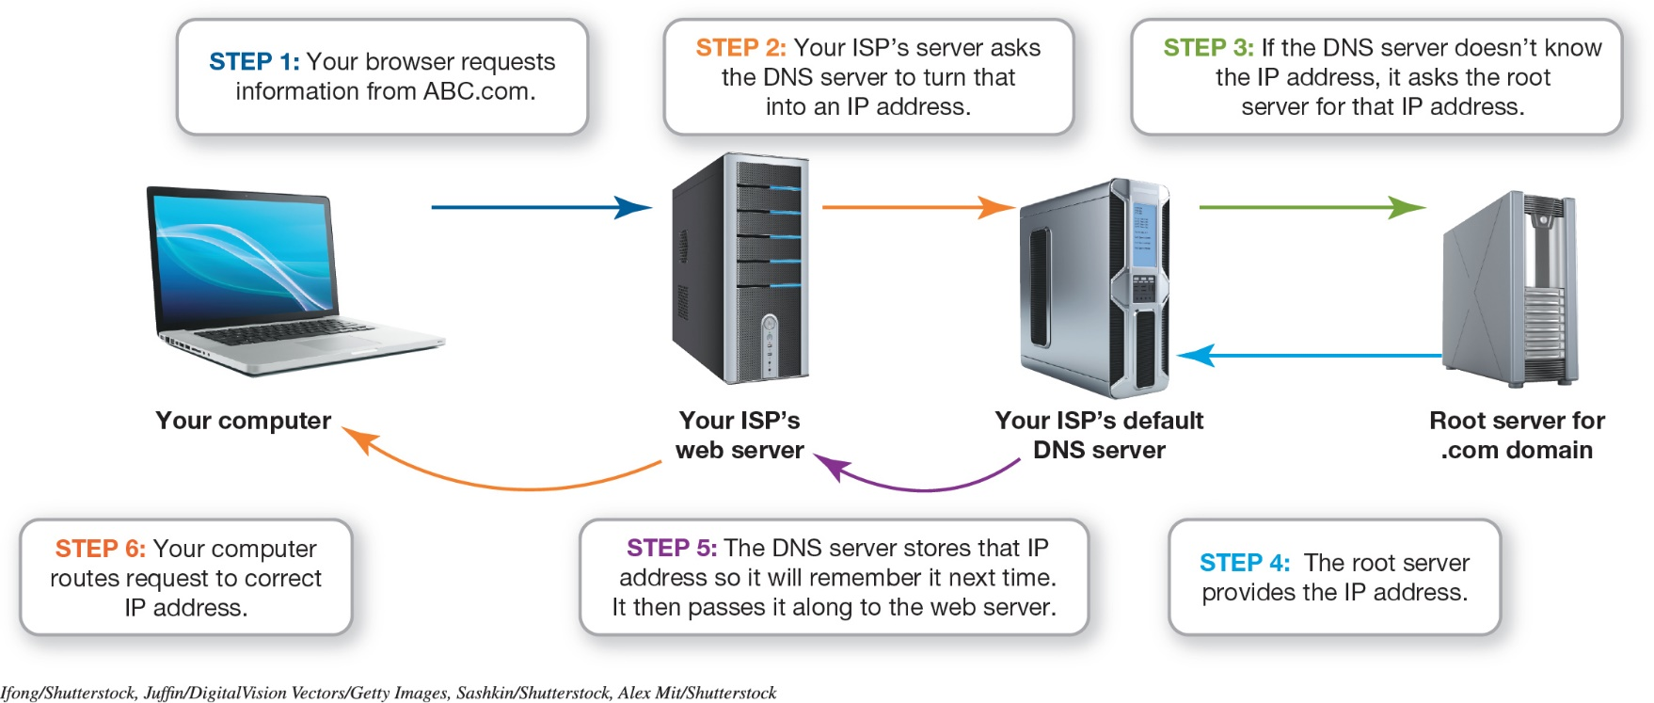
Internet Identity Domain Names (2 of 2) (Objective 13.5)
Computer converts URL to an IP address
Domain name system (DNS) server functions like an Internet phone book
Notes:
When you enter a URL in your browser, your computer converts the URL to an IP address.
To do this, your computer consults a database maintained on a domain name system (DNS) server that functions like a phone book for the Internet.
Figure 13.10 shows the DNS servers in action.

Slide 18
Web Technologies Web Development (1 of 4) (Objective 13.6)
HTML
Not a programming language
Set of rules for marking blocks of text
Browser knows how to display text
Surrounded by pairs of HTML tags
Tags and text referred to as an element
<b><i>This should be bolded and italicized.</i></b>
Notes:
HTML isn’t a programming language; it’s a set of rules for marking up blocks of text so that a browser knows how to display them.
Blocks of text are surrounded by pairs of HTML tags. HTML tags surround and define HTML content. Each pair of tags and the text between them are referred to as an element.
This example provides multiple tags combined in a single element: <b><i>This should be bolded and italicized.</i></b>.

Slide 19
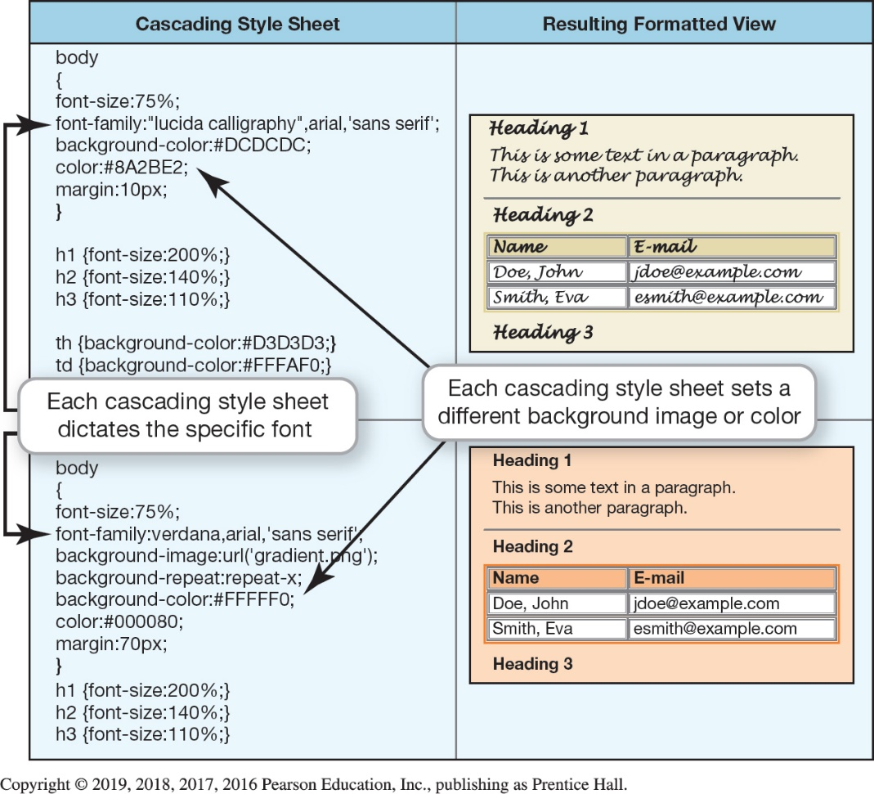
Web Technologies Web Development (2 of 4) (Objective 13.6)
Cascade style sheet (CSS) is a list of rules defining how to display HTML elements
Notes:
Figure 13.13 demonstrates that cascading style sheets allow developers to create formatting templates. Just as all the pages of this book have a similar look and feel, one style sheet can control the formatting of many web pages.

Slide 20
Web Technologies Web Development (3 of 4) (Objective 13.6)
XML is different from HTML
eXtensible Markup Language (XML) describes what data is
Users build markup languages to accommodate data formats and needs
Provides a method of data validation through XML schema diagrams (XSD)
JSON stands for JavaScript Object Notation
Data interchange that is easy for humans to read and write
Notes:
The eXtensible Markup Language (XML) describes what data is being described rather than how it’s to be displayed. Users can build their own markup languages to accommodate particular data formats and needs.
XML schema diagrams (XSD) allow you to specify all kinds of data validation for a specific XML tag.
Another popular format, JSON, stands for JavaScript Object Notation and is a data interchange standard that is easy for humans to read and write.

Slide 21
Web Technologies Web Development (4 of 4) (Objective 13.6)
Hypertext Transfer Protocol (HTTP) was created to transfer hypertext documents across the Internet
Hypertext Transfer Protocol Secure (HTTPS) ensures that data is sent securely over the web
SSL
TLS
Notes:
The Hypertext Transfer Protocol (HTTP) was created especially for the transfer of hypertext documents across the Internet.
Hypertext Transfer Protocol Secure (HTTPS) ensures that data is sent securely over the web.
HTTPS is actually an acronym that’s the combination of HTTP and Secure Sockets Layer (SSL), a network security protocol.
Transport Layer Security (TLS) is an updated extension of SSL.

Slide 22
Web Technologies Application Architecture (1 of 3) (Objective 13.7)
Server-side applications
The web is a client/server network
Program on server is considered server-side
Can require many communication sessions between client and server
Can perform very complex operations
Notes:
As you’ll recall, the web is a client/server network.
The type of program that runs on a web server rather than on your computer is referred to as a server-side program.
Server-side program execution can require many communication sessions between the client and the server to achieve the goal, but server-side programs can perform very complex operations.

Slide 23
Web Technologies Application Architecture (2 of 3) (Objective 13.7)
Client-side applications
Programs that run on client computer
Require no interaction with web server
New data is only sent in response to a request
Exchange of data can make interactivity inefficient and slow
More efficient on local computer
Notes:
A client-side program runs on the client computer and requires no interaction with a web server.
The receiving computer can’t get new data from the server unless a new request is made.
If interactivity is required on a web page, this exchange of data between the client and server can make the interactivity inefficient and slow.
Often, it’s more efficient to run programs on your computer. Therefore, client-side programs are created.

Slide 24
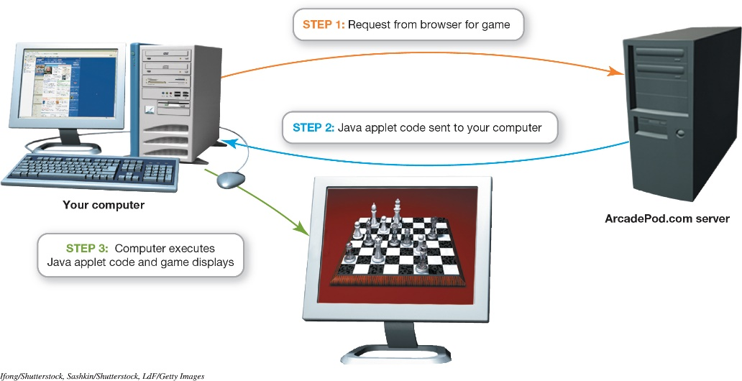
Web Technologies Application Architecture (3 of 3) (Objective 13.7)
JavaScript
Commonly used scripting language
Document Object Model (DOM)
Organize objects and page elements
Notes:
JavaScript is a commonly used scripting language for creating DHTML effects.
Document Object Model (DOM) organizes the objects and page elements.

Slide 25
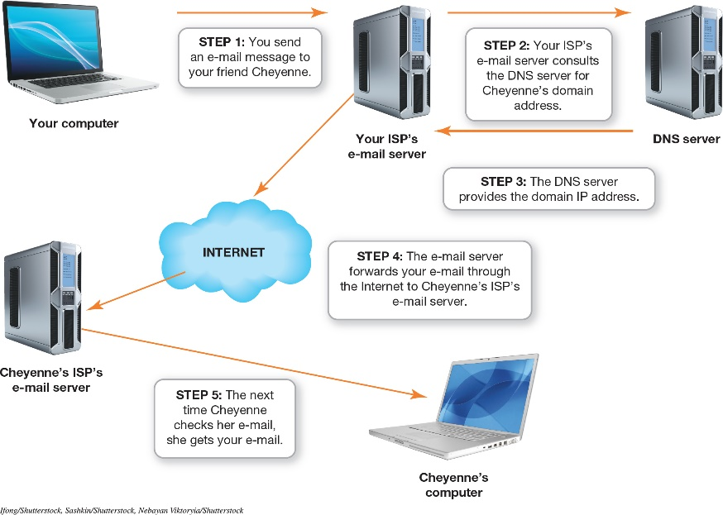
Communications Over the Internet Types of Internet Communication (1 of 2) (Objective 13.8)
E-mail is one of the most common communication methods
Created in 1971
Simple Mail Transfer Protocol (SMTP) is responsible for sending e-mail
Multipurpose Internet Mail Extensions (MIME) allows sending of files
Notes:
E-mail is one of the most common communication methods on the Internet.
In 1971, Ray Tomlinson created e-mail from a simple program he wrote to enable users to leave text messages for each other on a single machine.
The Simple Mail Transfer Protocol (SMTP) is responsible for sending e-mail along the Internet to its destination.
When the need arose to send files by e-mail, the Multipurpose Internet Mail Extensions (MIME) specification was introduced.
Figure 13.17 shows a sample route an e-mail takes on the Internet.

Slide 26
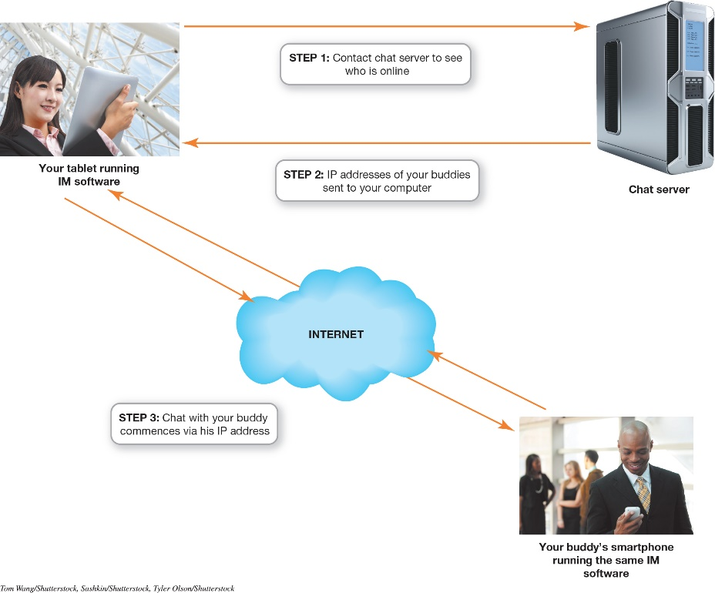
Communications Over the Internet Types of Internet Communication (2 of 2) (Objective 13.8)
Instant messaging
Another very common communication method
Uses a client program
Makes connection with chat server
Chatting takes place between two devices
Notes:
Instant messaging (IM) requires the use of a client program that connects to an IM service.
The client software running on your device makes a connection with the chat server and provides it with connection information.
Because your device and your friend’s device have the connection information for each other, the server isn’t involved in the session.
Chatting takes place directly between the two devices.
Figure 13.18 shows how an instant messaging program works.

Slide 27
Communications Over the Internet Encryption (1 of 3) (Objective 13.9)
Encryption
Email is susceptible to being read by unintended parties
Might remain on servers
Process of coding e-mail so that only the person with the key can decode the message
Notes:
Encryption is necessary for e-mail because email is susceptible to being read by unintended parties.
It might also remain on servers either permanently or temporarily.
Encryption is the process of coding e-mail so that only the person with the key can decode the message.

Slide 28
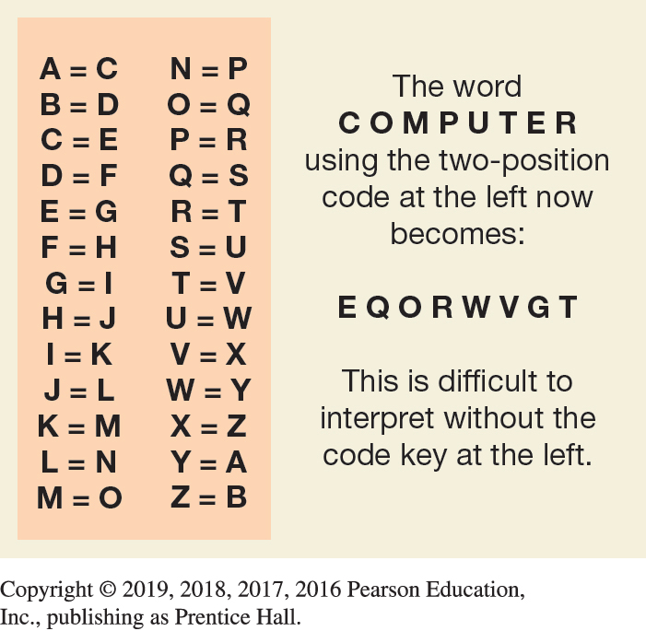
Communications Over the Internet Encryption (2 of 3) (Objective 13.9)
Private-key encryption
Only the two parties have the code
Could be a shift code
Could be more complex substitution code
Main problem is key security
Notes:
In private-key encryption, only the two parties involved in sending the message have the code. This could be a simple shift code where letters of the alphabet are shifted to a new position.
The main problem with private-key encryption is key security. If someone steals a copy of the code or is savvy about decoding, the code is broken.

Slide 29
Communications Over the Internet Encryption (3 of 3) (Objective 13.9)
Public-key encryption
Two keys (key pair) are created
One for coding, one for decoding
Coding key is distributed as public key
Message being sent is coded using public key
Decode using private key
Only receiver knows private key
Mathematical relationship between two keys
Pretty Good Privacy (PGP) are available for download
Notes:
In public-key encryption, two keys, known as a key pair, are created. You use one key for coding and the other for decoding.
The public key is used for coding. You can place this key on your website. Anyone wishing to send you a message can download your public key and code the message using your public key.
The private key is generated first. The public key is then generated using a complex mathematical formula.
Public-key packages such as Pretty Good Privacy (PGP) are available for download.

Slide 30
Questions
?

Slide 31
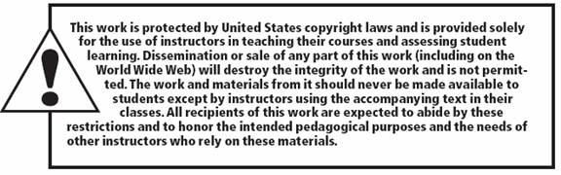
Copyright
All rights reserved. No part of this publication may be reproduced, stored in a retrieval system, or transmitted, in any form or by any means, electronic, mechanical, photocopying, recording, or otherwise, without the prior written permission of the publisher. Printed in the United States of America.

